Slide 1
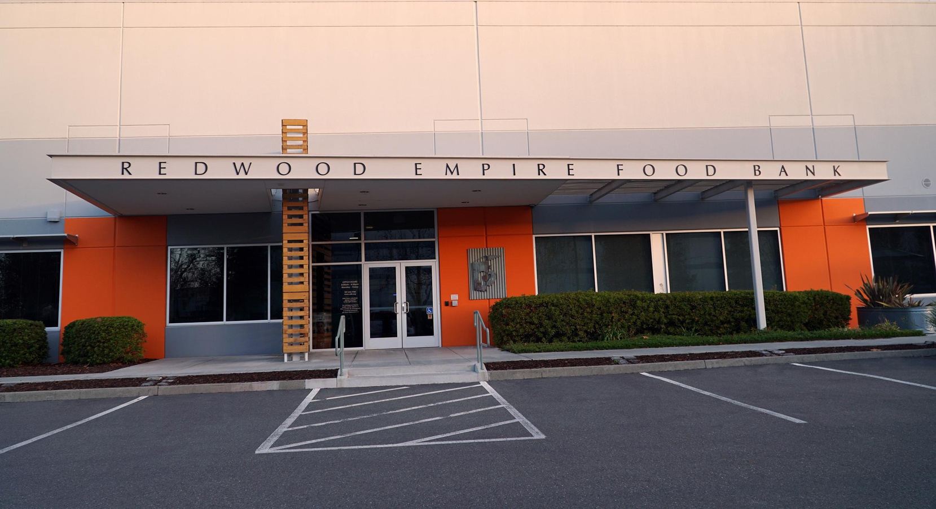



Redwood Empire Food Bank
What We Do & How You Can Support!

Slide 2
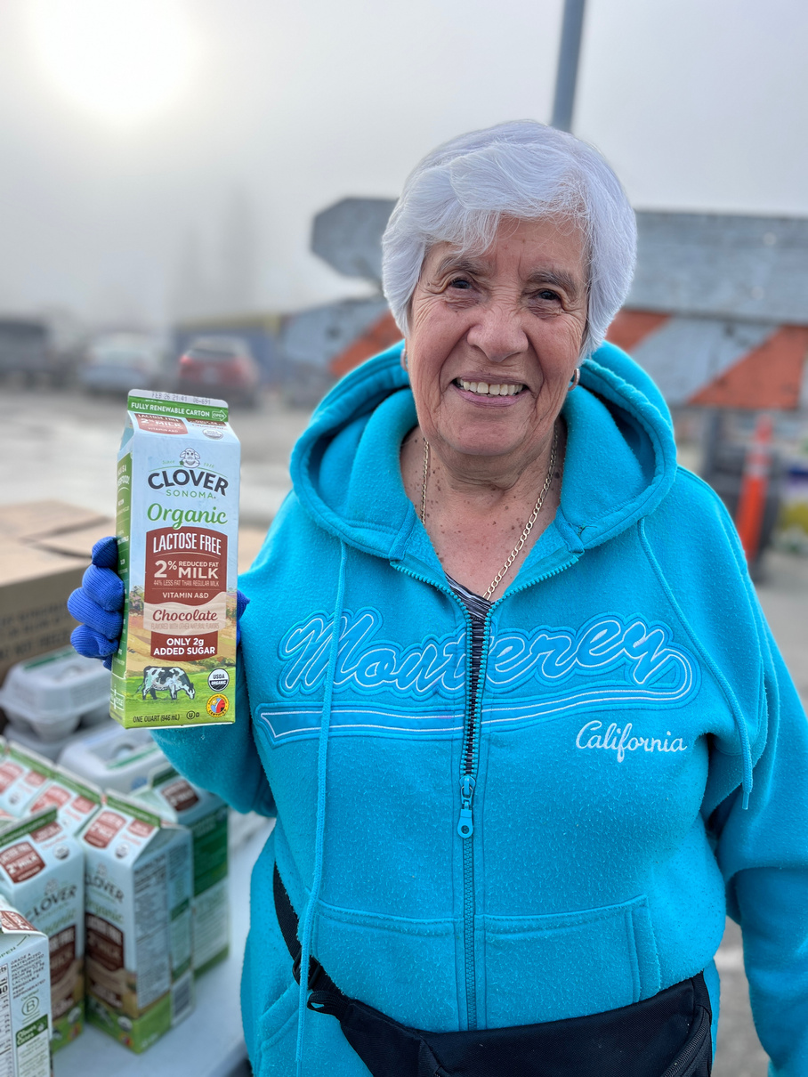
Why we’re here is simple:
people are hungry.
We can help them. And we do. However, what we do—and how we do it—is complicated.

Slide 3
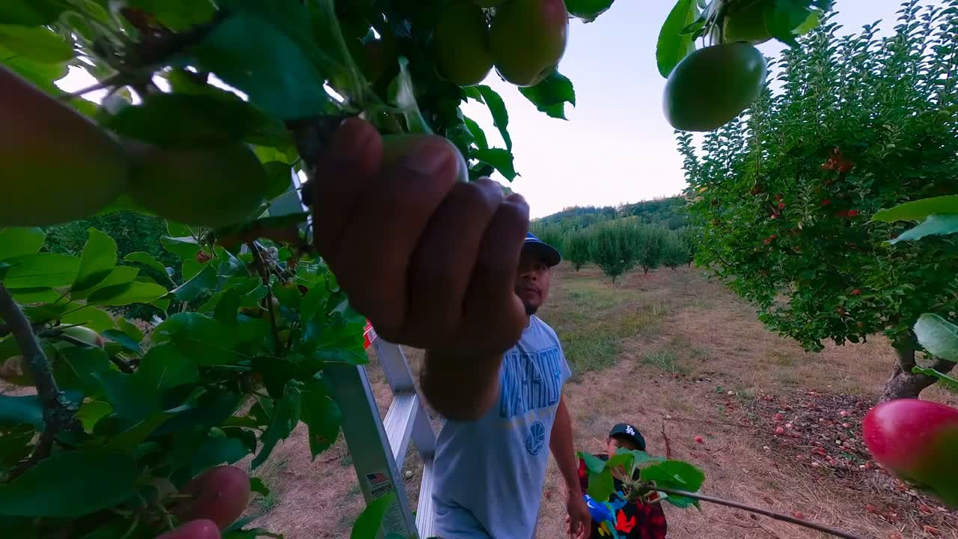

Slide 4
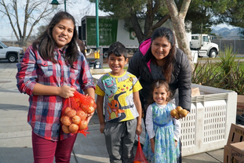

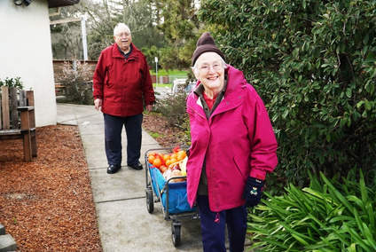

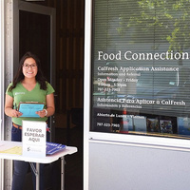

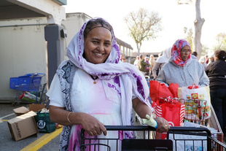
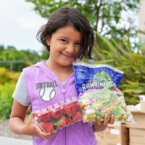
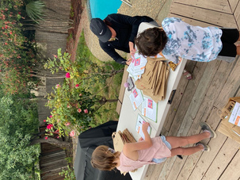
Hunger-Relief Programs
In an effort to effectively reach the 142,000
people struggling with food insecurity, the Redwood Empire Food Bank operates
300 monthy food distributions under three strategic hunger relief initiatives:
•Every Child, Every Day
•Senior Security
•Neighborhood Hunger Network

Slide 5
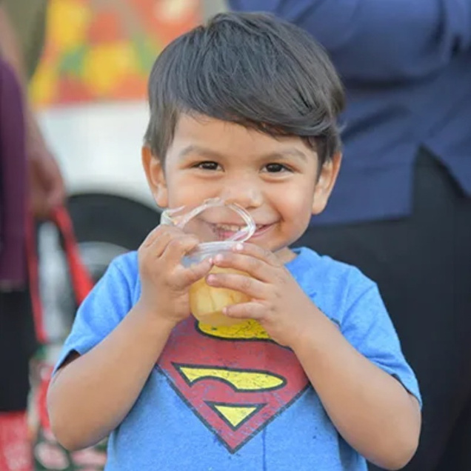
Every Child, Every Day
Four robust programs ensure a healthy start in life for our littlest neighbors in need, providing
food to 48,000 at-risk children.
After-School Cafe
Summer Lunch
School Pantry
Preschool Pantry

Slide 6
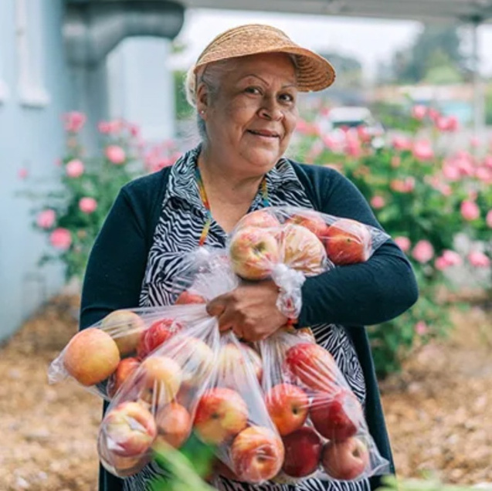
Senior Security
Our Senior Basket program provides food monthly to 15,600 low-income seniors and 3,000 Veterans, giving them the nutritional stability and resources they need to lead healthy, independent lives.
Senior Basket Box
Operation End Hunger

Slide 7
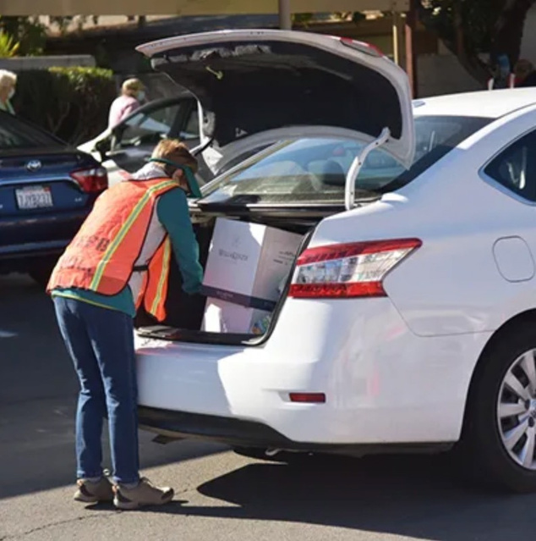
Neighborhood Hunger Network
We provide groceries to anyone in need through a variety of programs that improve the health and well-being of 142,000 individuals monthly in our community.
Groceries to Go
Produce Pantry
Food Connections Market - Partner Organizations
Food Connections Resouce Office

Slide 8
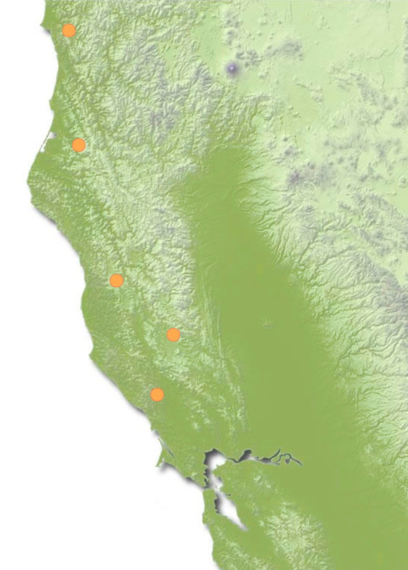

DEL NORTE COUNTY
Distribution of the Provision of Help
HUMBOLDT COUNTY
We distribute food at more than 300 weekly and monthly distribution sites through our own programs and with the support of over 150 partner organizations in the following
counties:
•Sonoma
•Lake
•Mendocino
•Humboldt
•Del Norte
MENDOCINO COUNTY
LAKE COUNTY
SONOMA COUNTY

Slide 9
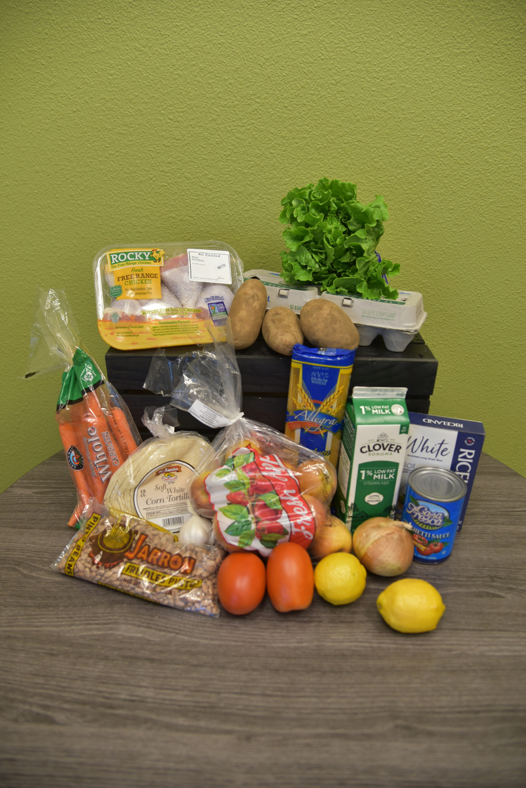
$74.5 Million of food distributed in 2024....
equivalent to 25.8 million meals
Offering: 47% produce, 9% protien, 10% dairy, & 34% dry goods
Source: 43% purchased produce, 9% puchased staples, 27% donated, & 21% governtment (USDA) food

Slide 10
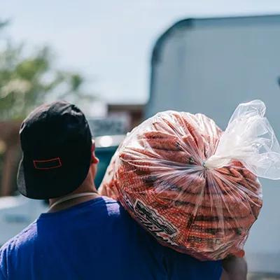
Funding Breakdown
For every $1 received
we’re able to provide
$3 worth of food

Slide 11
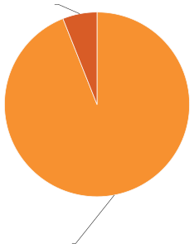


Expenses Breakdown
General Operating Expenses 7%
93%
of the
Redwood Empire Food Bank’s
expenses go directly to
hunger-relief programs
Hunger-Relief Programs 93%

Slide 12
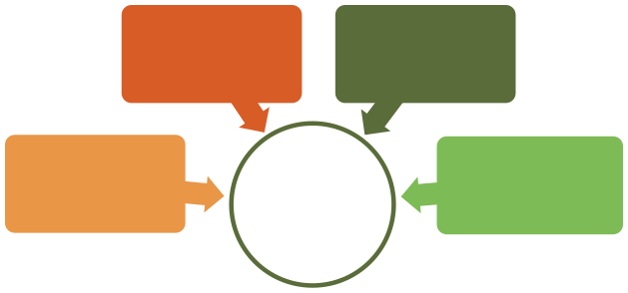
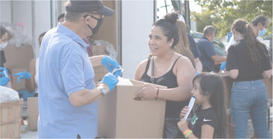
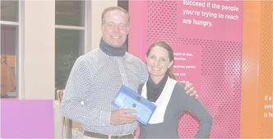
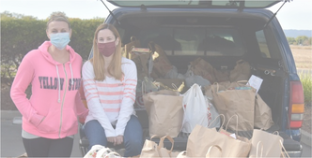

How the community can help!
VOLUNTEER
DONATE FUNDS
Our mission at the Redwood Empire Food Bank is simple:
To End Hunger in Our
Community.
But we can’t accomplish this important work alone.
END HUNGER
DONATE FOOD
ADVOCATE

Slide 13
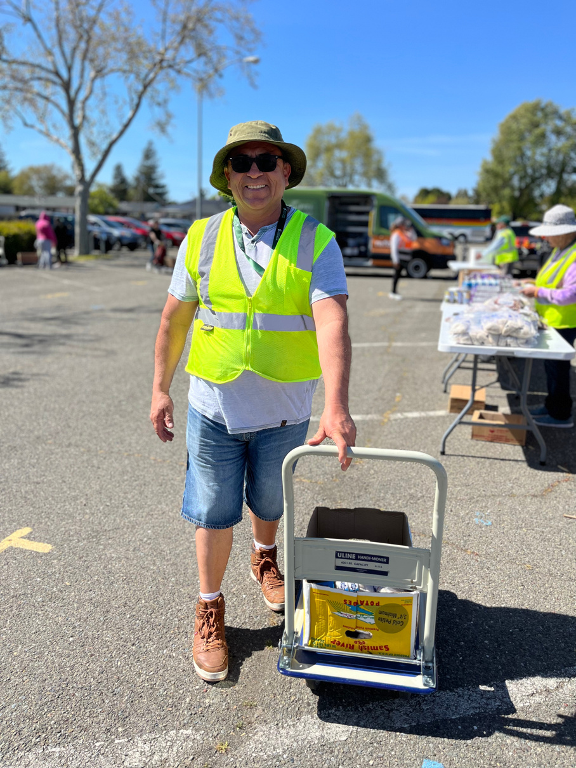
Volunteer Support
Volunteers are critical to ending hunger in our community. We need the support of over 11,000 dedicated volunteers to:
Warehouse
Kitchen Collective
Food Connections Market
Distribution Sites & W5 Volunteers
Special Events

Slide 14
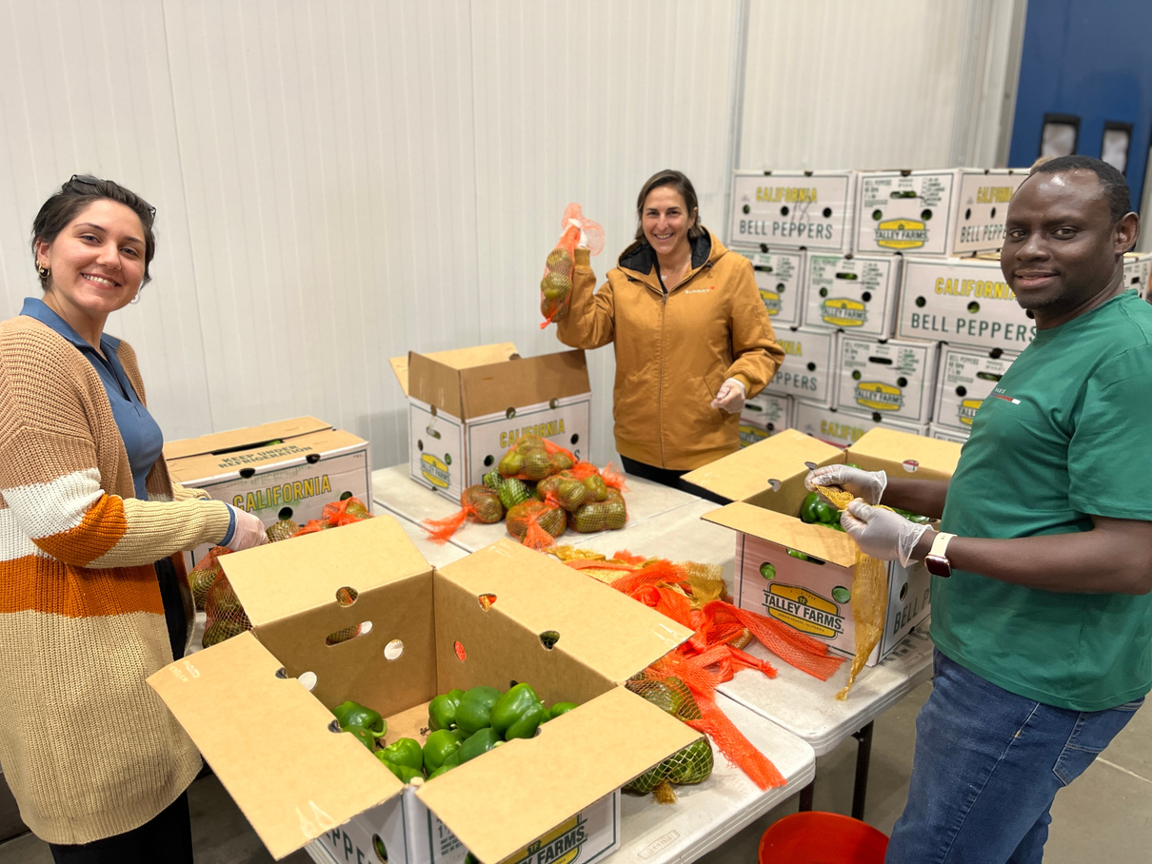
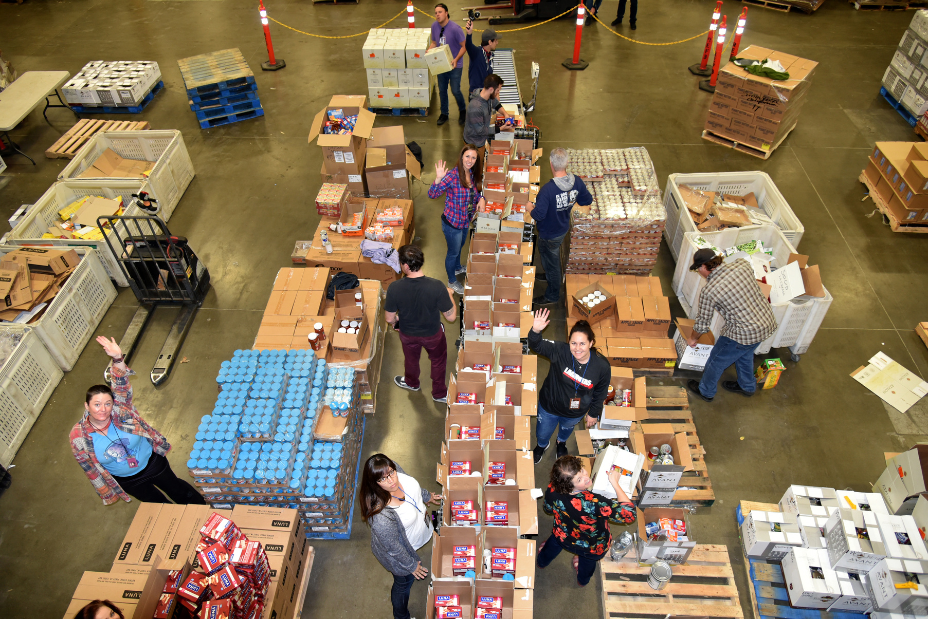
Warehouse Volunteers

Slide 15
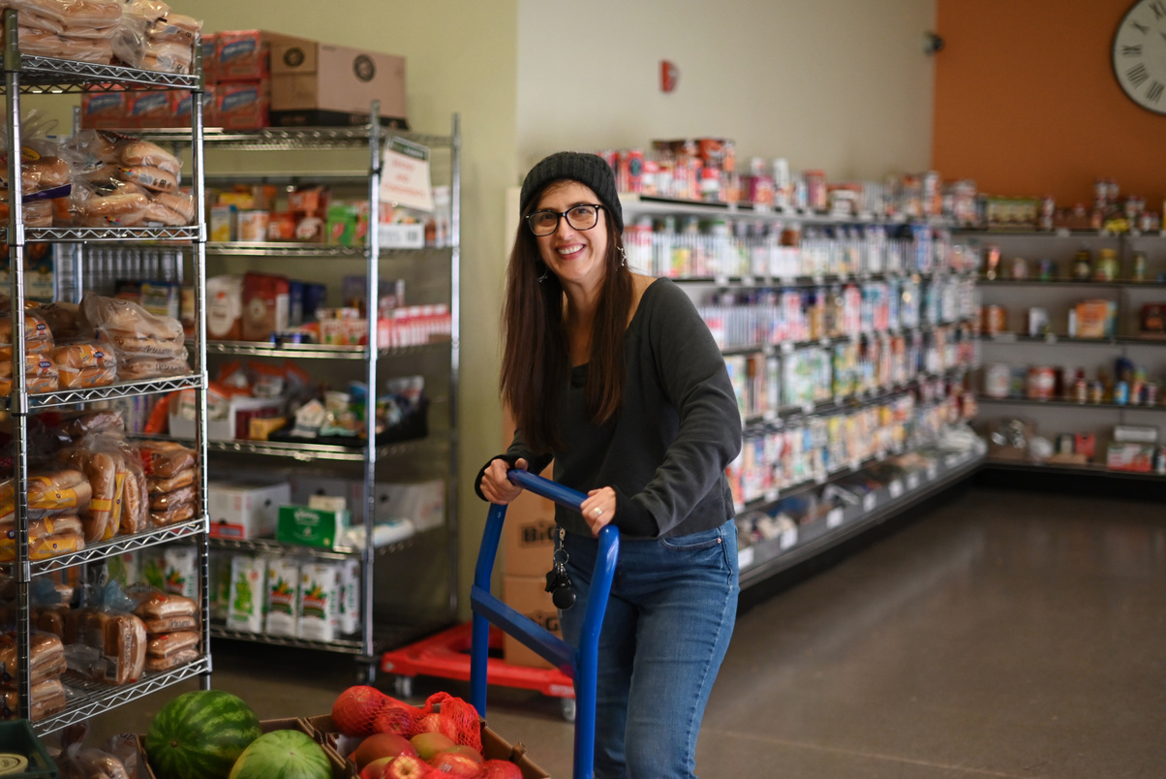
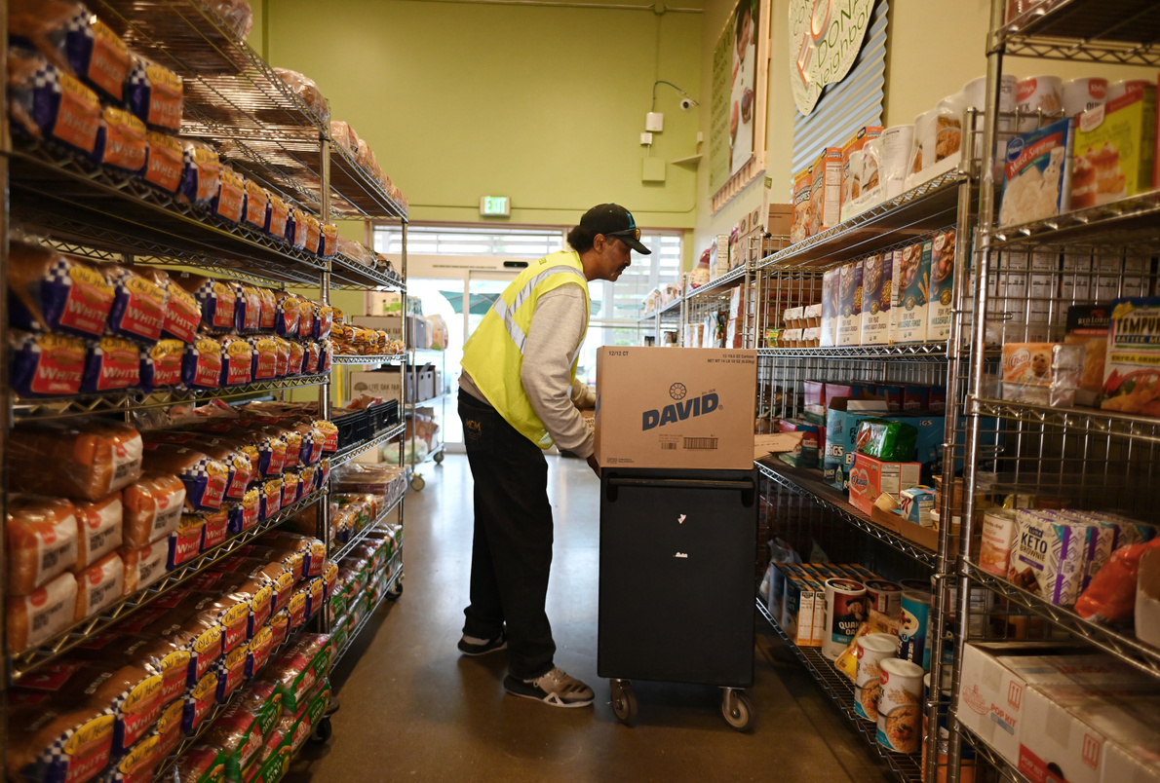
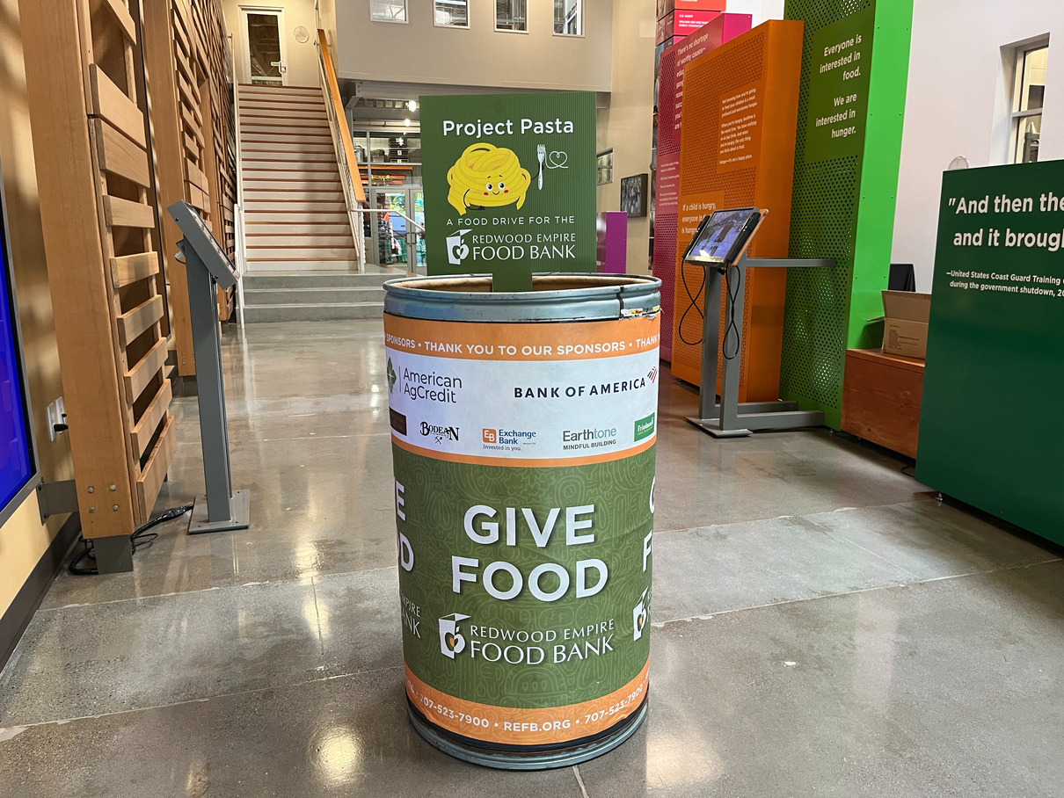
Food Connections Market Volunteers

Slide 16
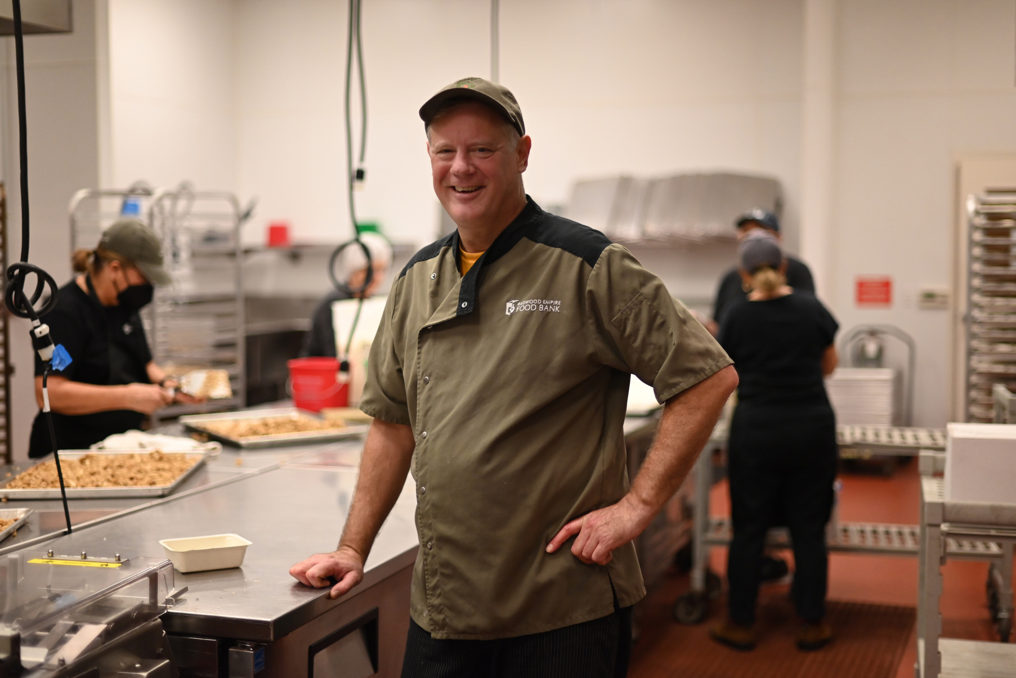
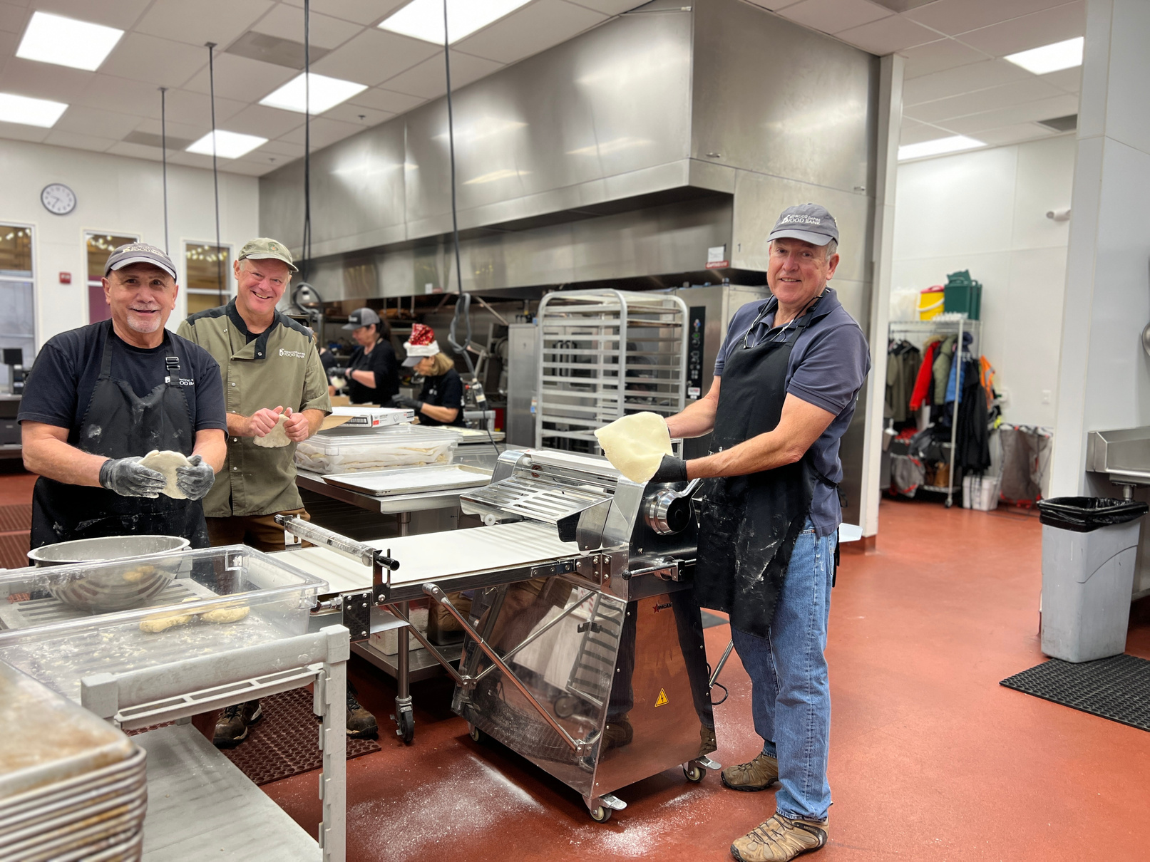
Kitchen Collective Volunteers

Slide 17
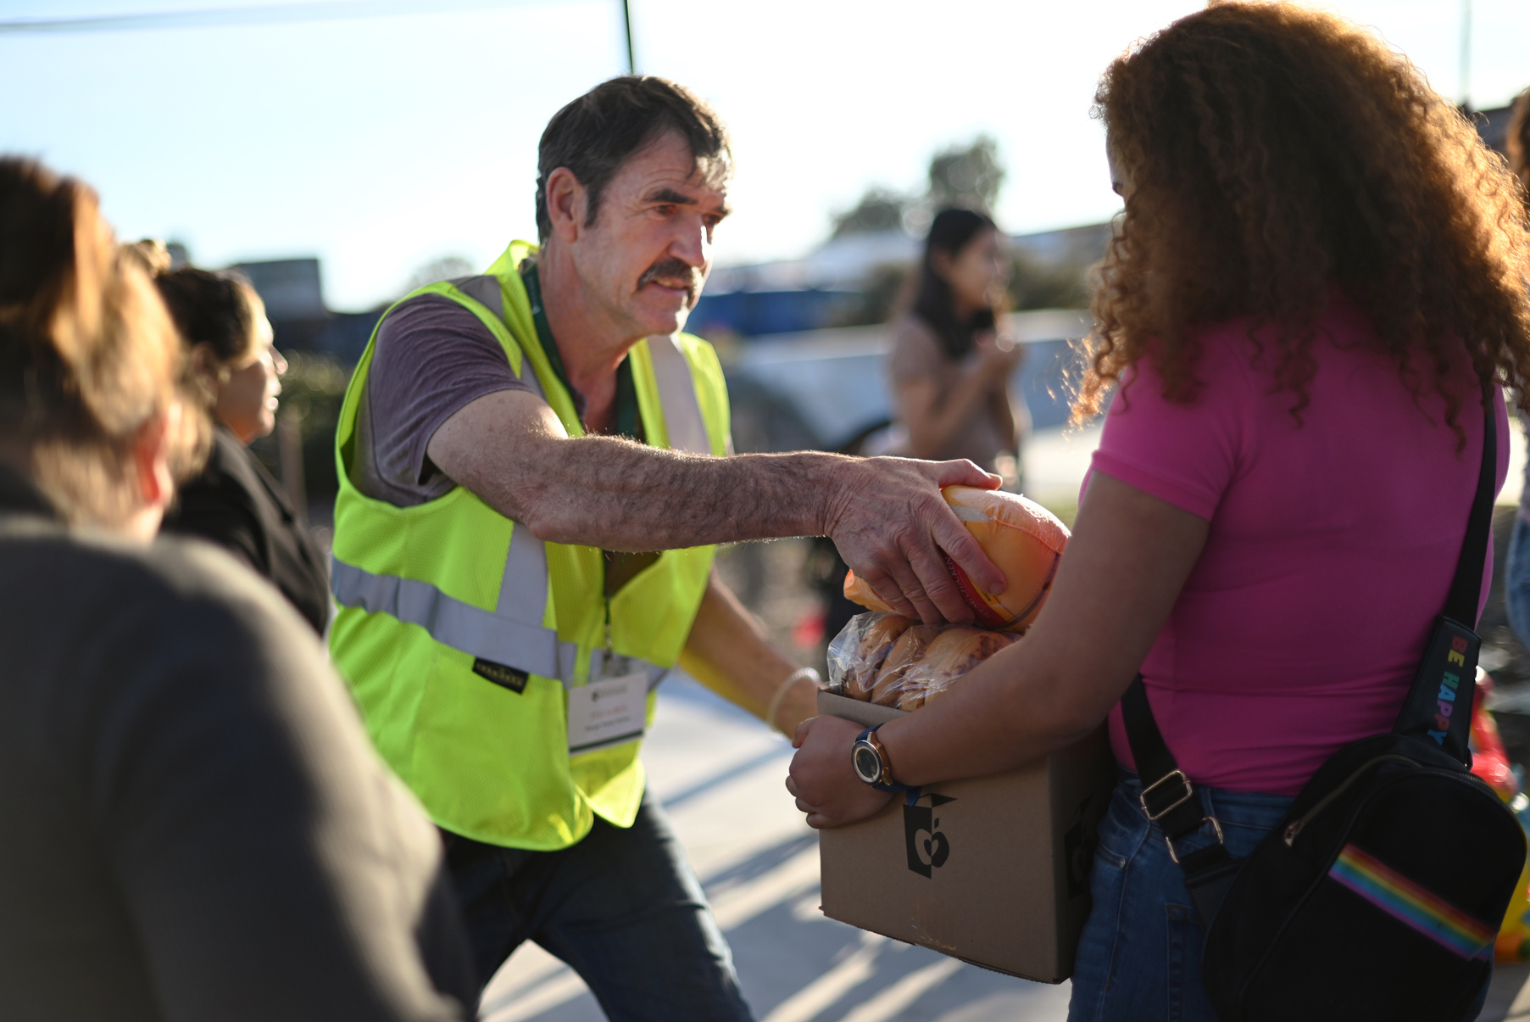
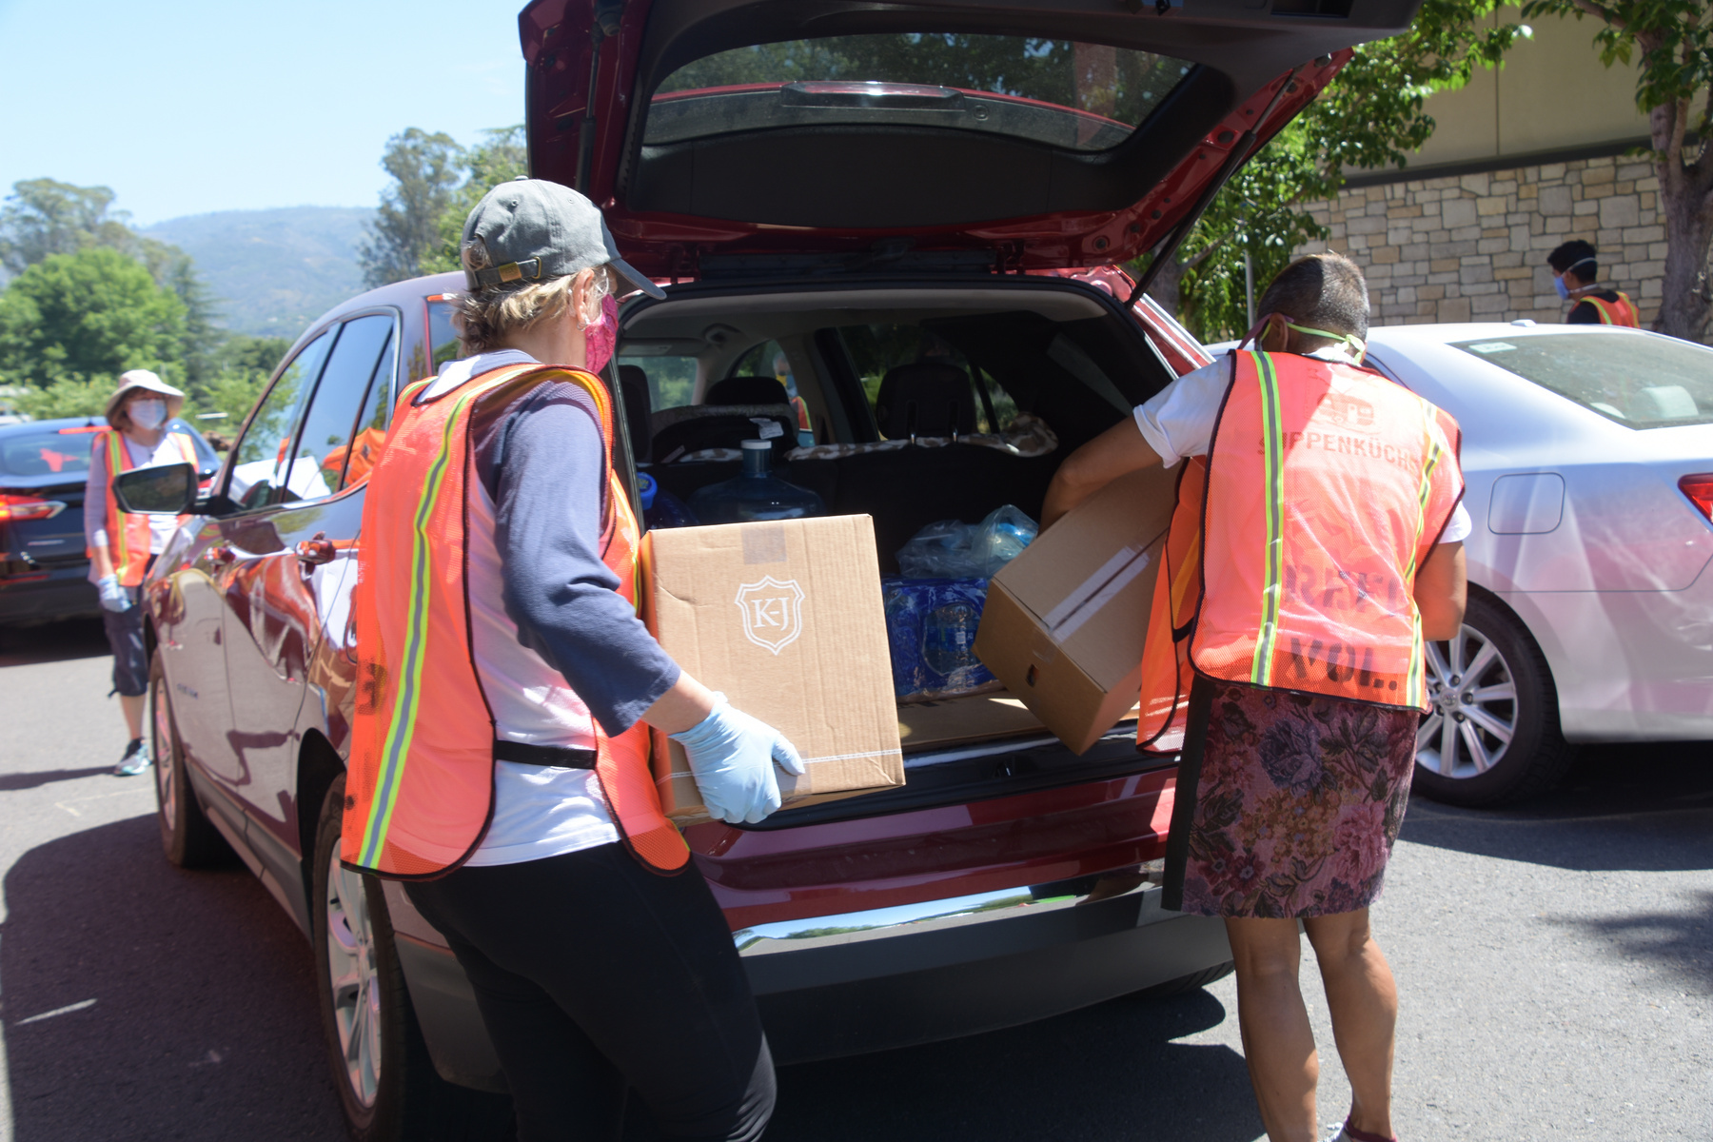
Distribution Site Volunteers

Slide 18
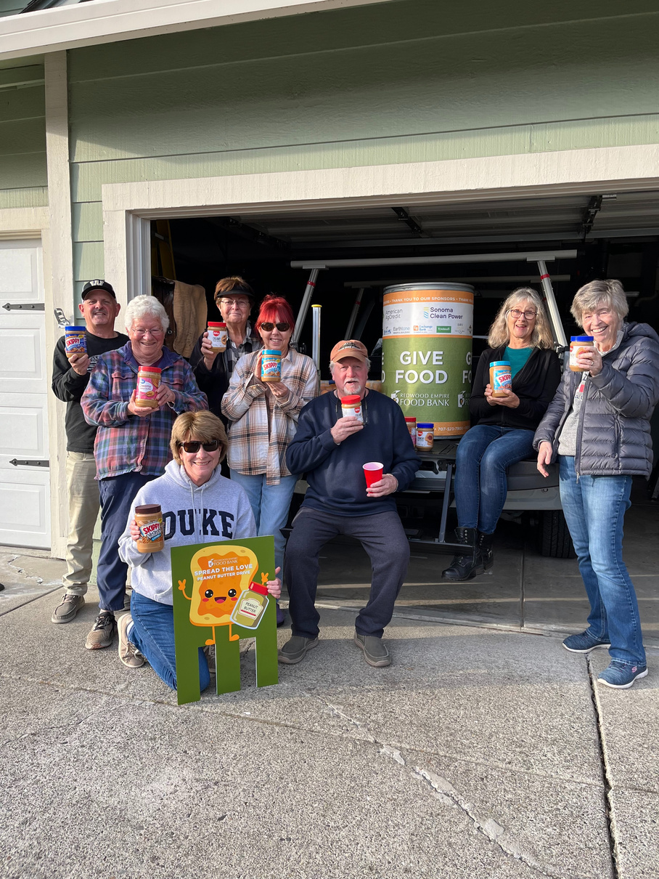
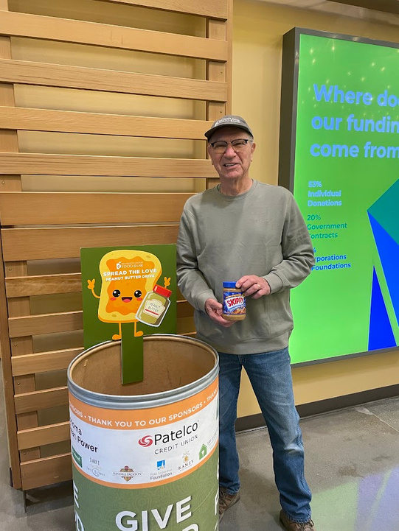
Special Event Volunteers

Slide 19
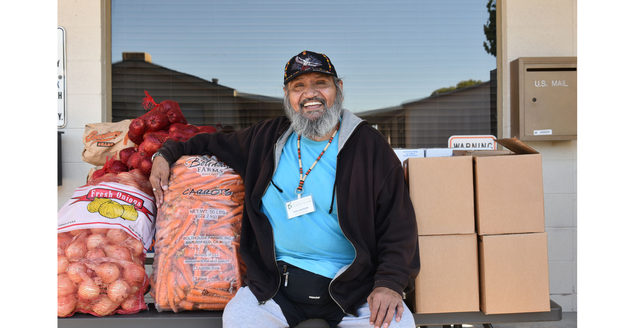
Thank you for your ongoing support!

